Slide 1
HEMATOPATHOLOGY
Case 4
Marianne de Castro Gonçalves
Rede D´Or São Luiz

Slide 2
Declaração de Conflito de Interesse
Dra. Marianne de Castro Gonçalves afirma não ter conflito
de interesse a declarar
Exigência da RDC Nº 96/08 da ANVISA

Slide 3
Clinical data
Male patient, 70 years old
Six months of progressive constipation, abdominal distension and weight loss (about 10 kg)
Intense night sweats two weeks before seeking medical assistance
PB: mild anemia

Slide 4

Imaging exams
CT
Parietal thickening of the sigmoid colon (11 cm)
Multiple lymphnode enlargement, more prominent in the mesentery coalescent (bulky 12 cm)
Diffuse peritoneal thickening with multiple nodules and ascites
Colonoscopy
Infiltrative and ulcerated lesion in the rectosigmoid transition
Sigmoid lesion and perithoneal thickening were biopsied

Slide 5
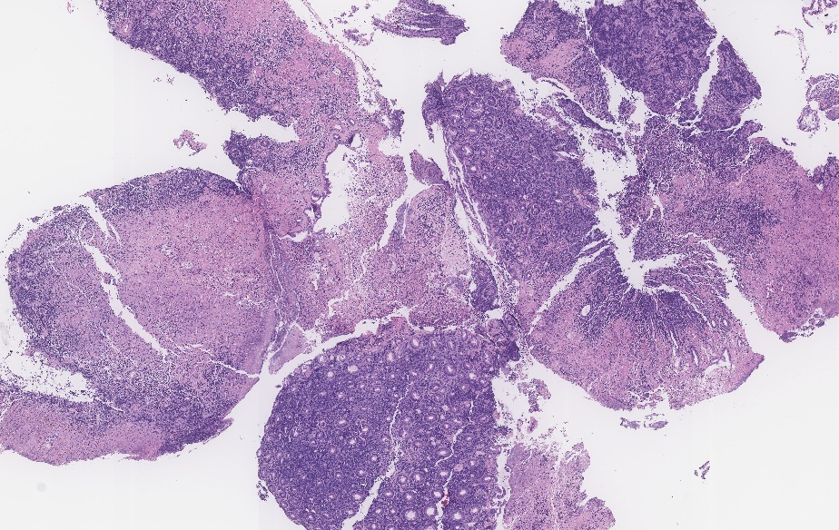
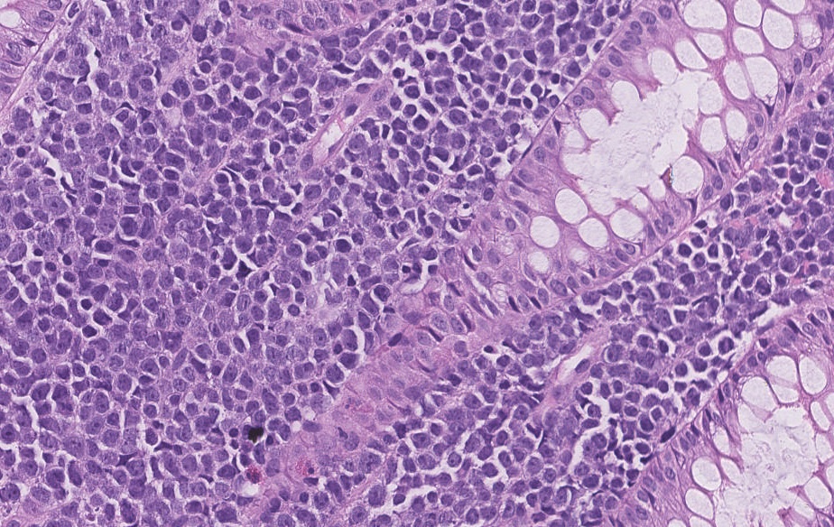
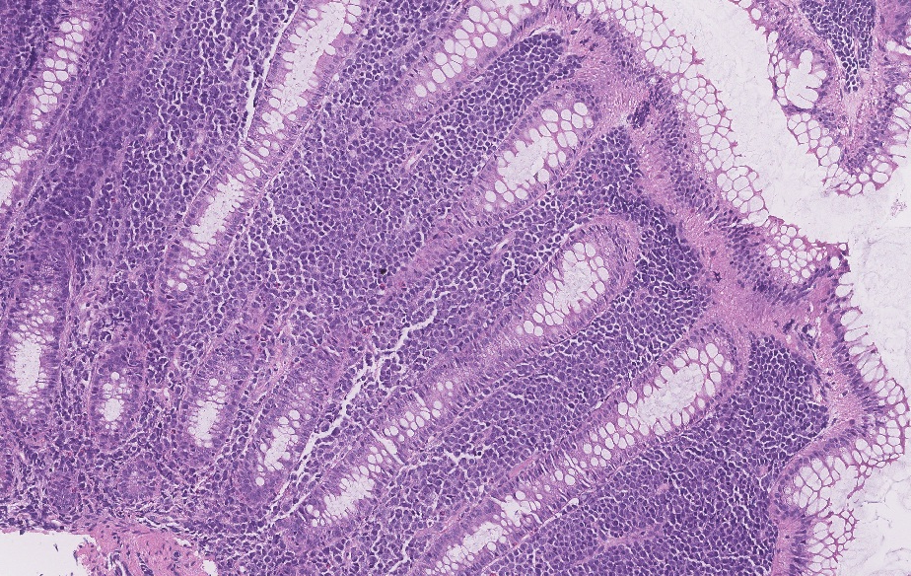

Slide 6
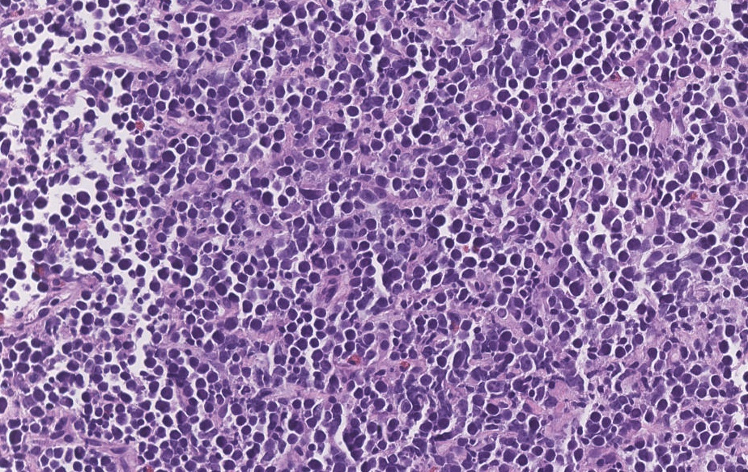

Slide 7
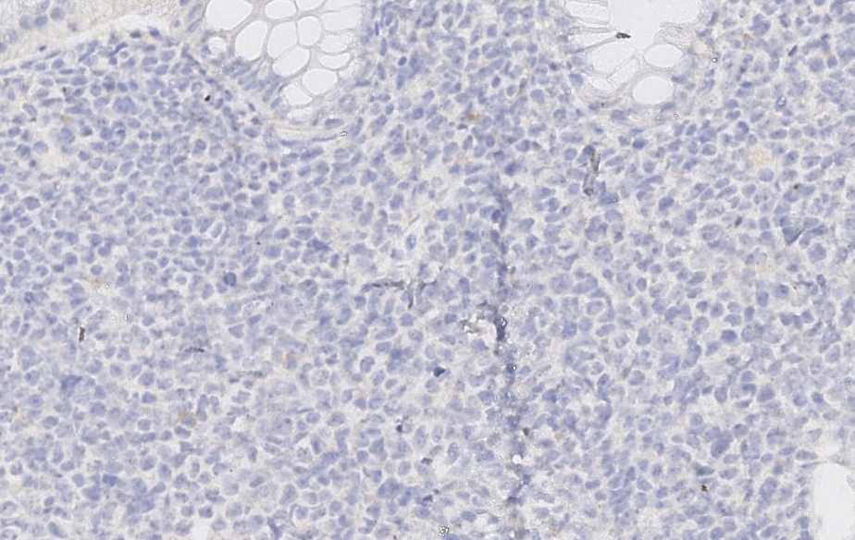
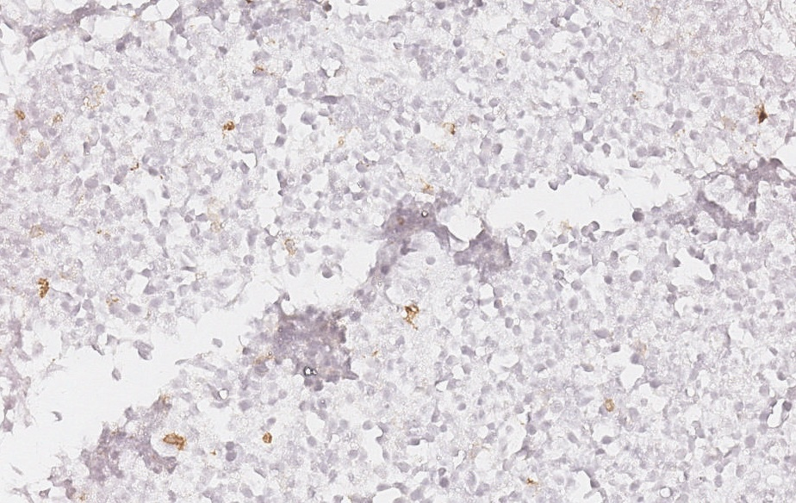
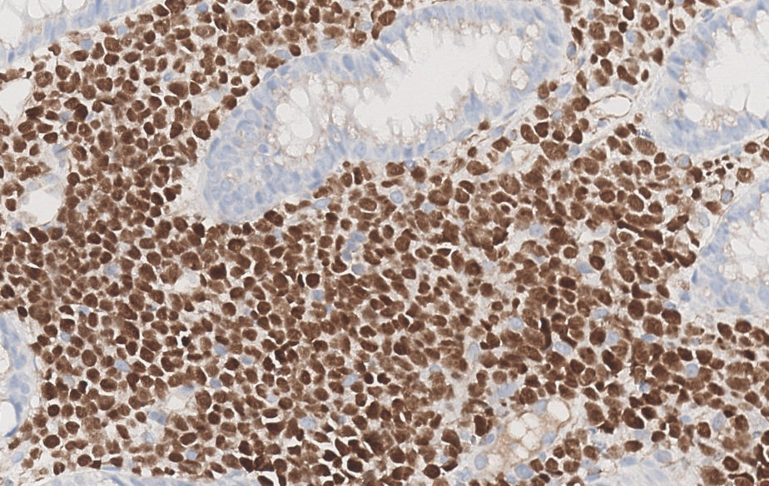
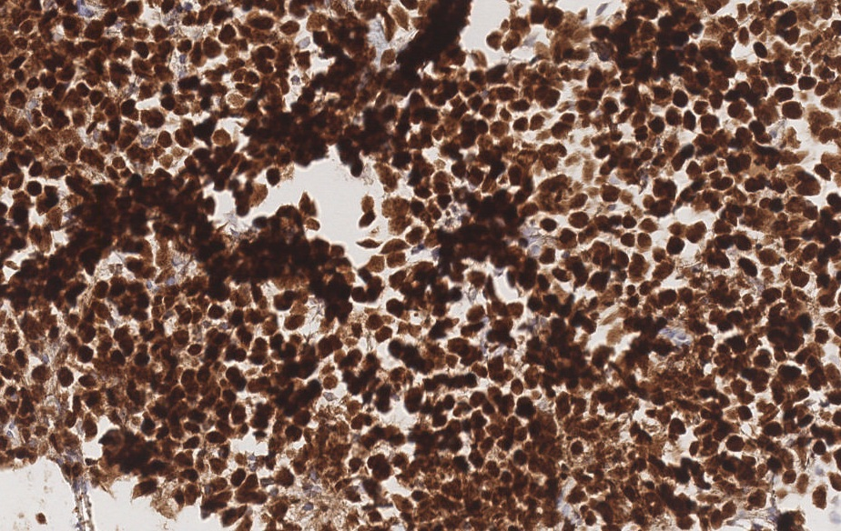
CD20
CD20
PAX5
PAX5

Slide 8
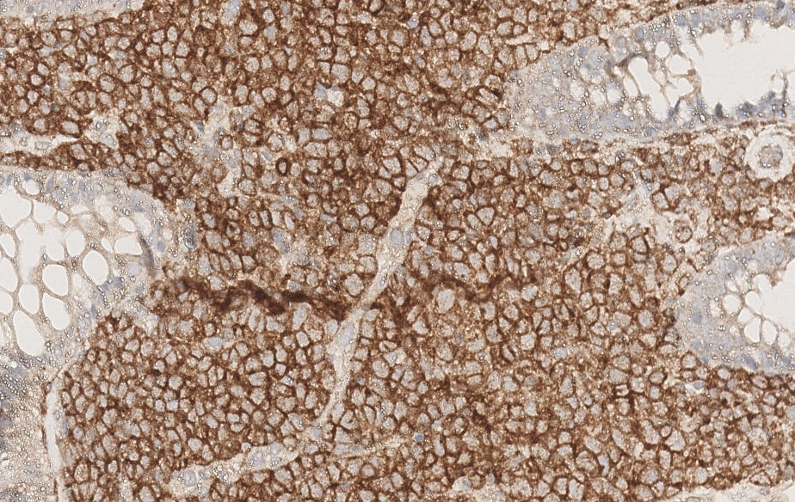
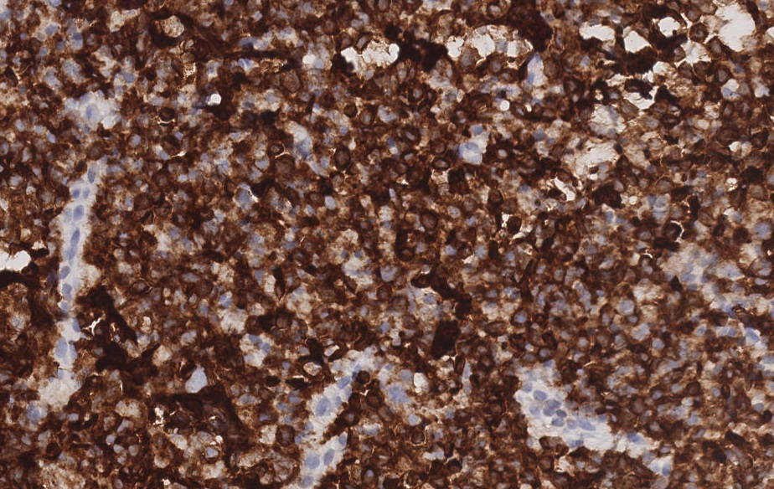
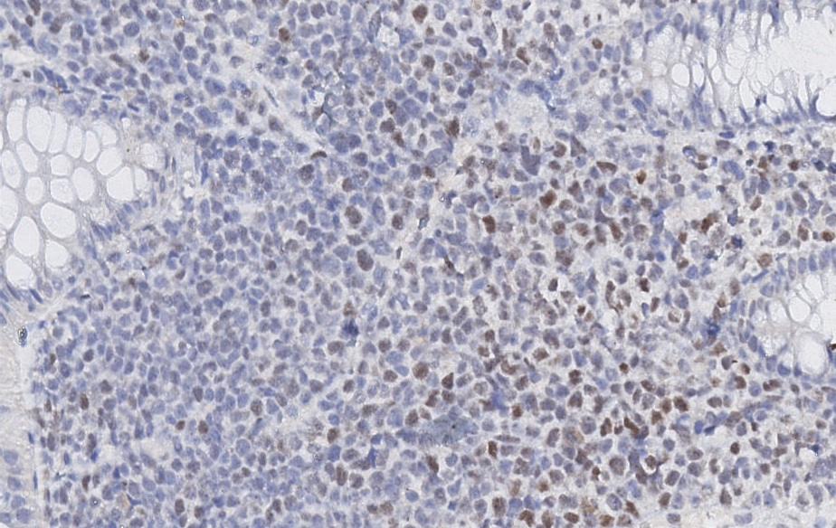
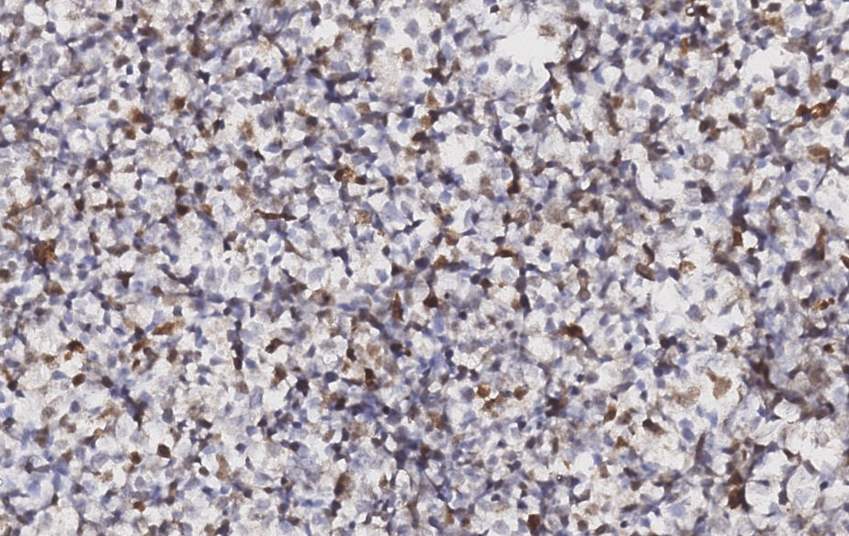
CD10
CD10
BCL-6
BCL-6

Slide 9
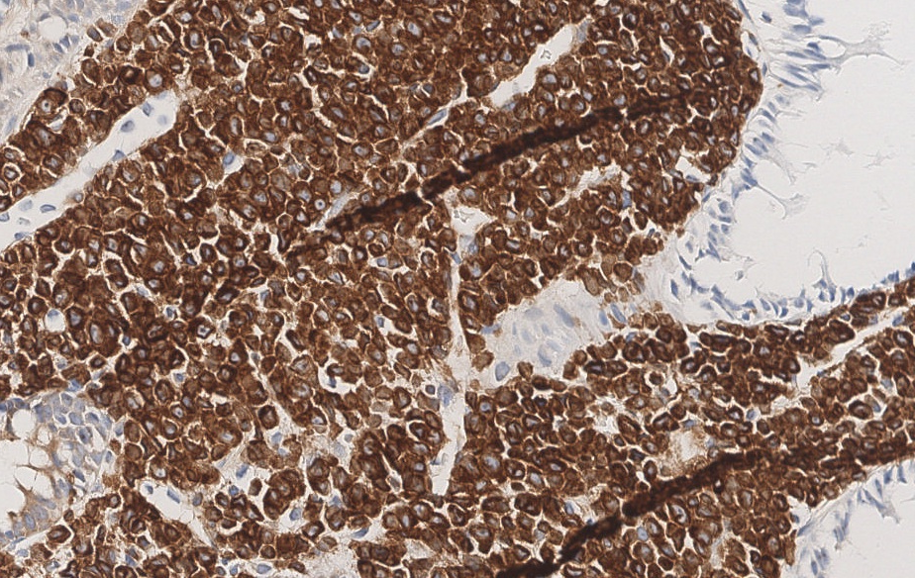
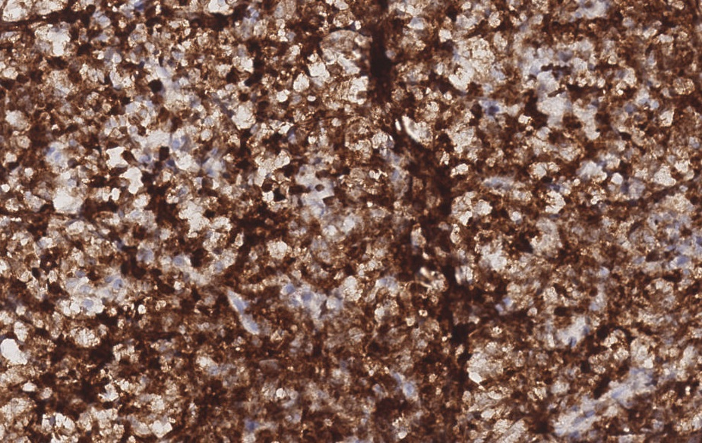
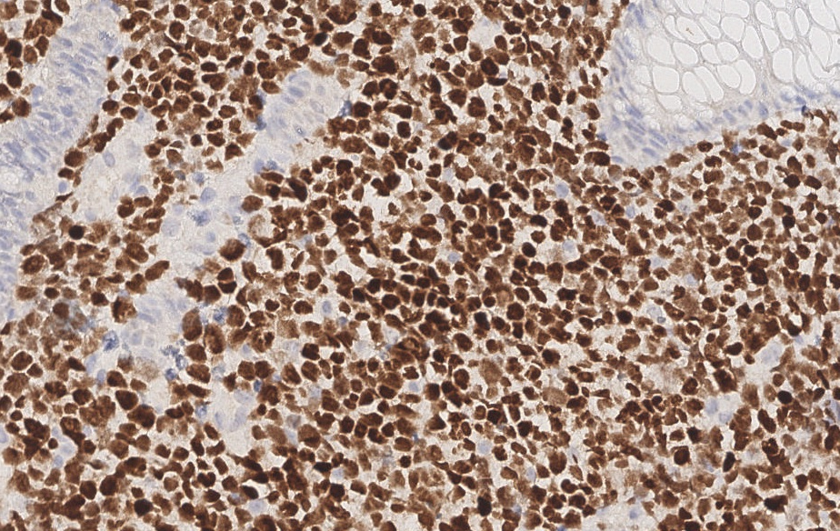
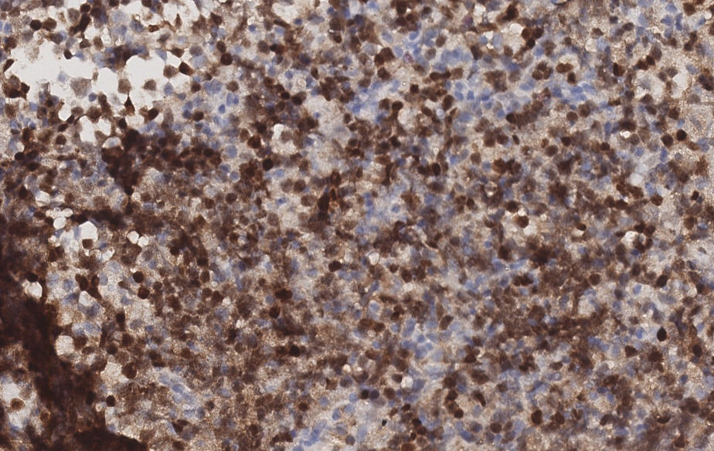
BCL-2
BCL-2
MUM-1
MUM-1

Slide 10
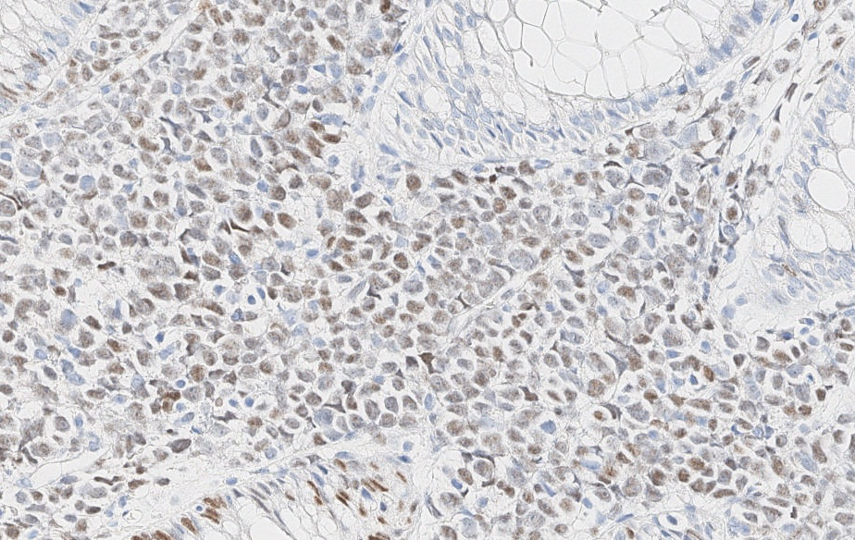
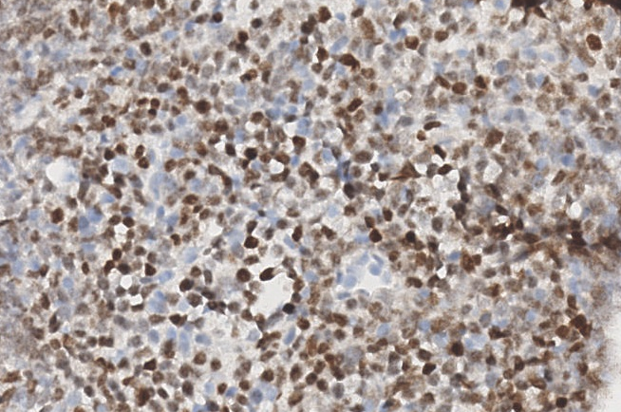
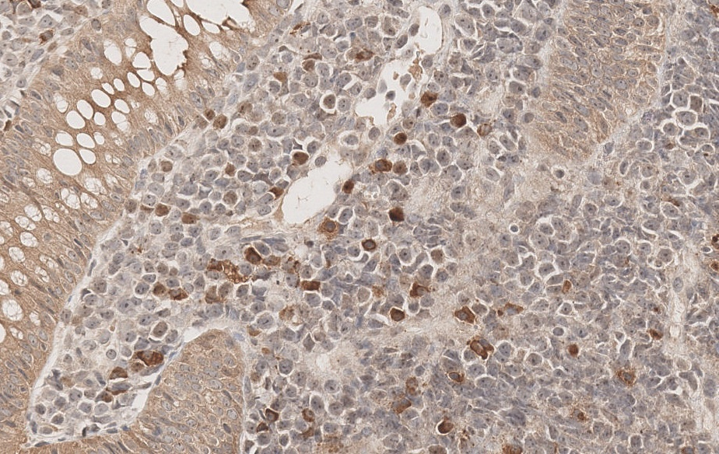
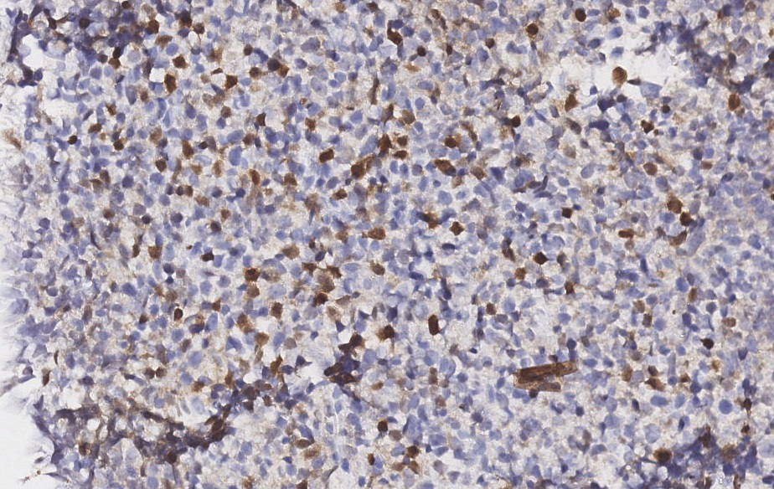
C-MYC
C-MYC
TDT
TDT

Slide 11
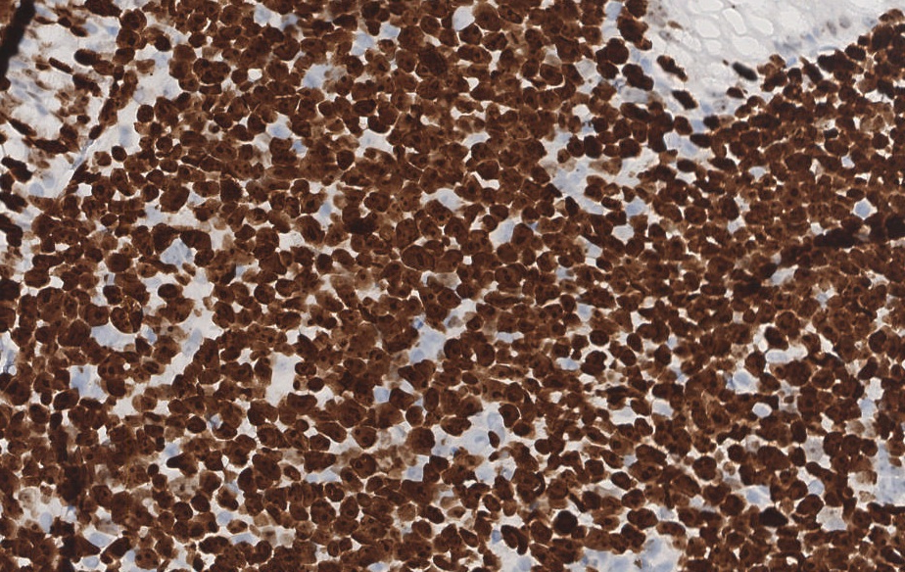
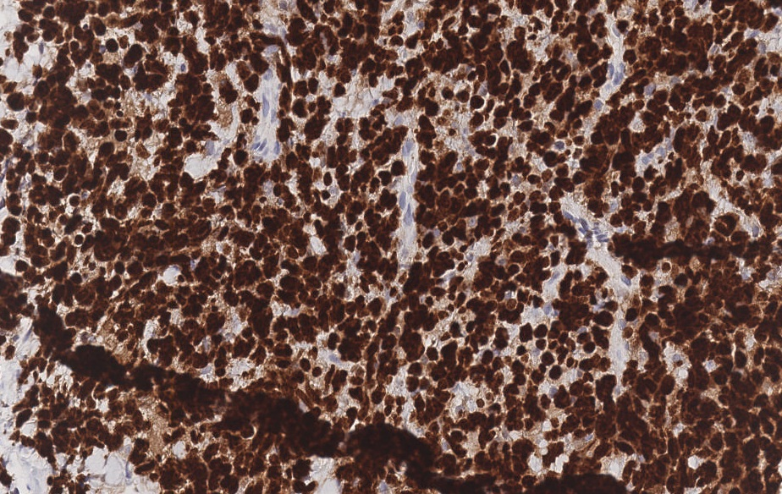
KI-67
KI-67

Slide 12
Other markers
CD3 - Negative
CD34 – Negative
CD117 – Negative
CD99 – Negative
CD5 – Negative
Cyclin-D1 – Negative
SOX-11 – Negative
EBER - Negative

Slide 13
Diagnosis
• Aggressive B-cell lymphoma with blastoid features, CD20-negative - see comments.
Comments:
1. It is a B-cell (PAX5+/CD20-) lymphoma with intermediate cells and an immature appearance (blastoid), with heterogeneous expression of TdT. Possible differential diagnoses in this case are a High-grade B-cell lymphoma with MYC and BCL2 +/- BCL6 rearrangements and TdT expression or a B lymphoblastic lymphoma; the latter hypothesis being disfavored by the epidemiological and morphological characteristics as well as CD34 negativity
2. FISH is recommended to define the case - the test can be performed on this material upon medical request

Slide 14
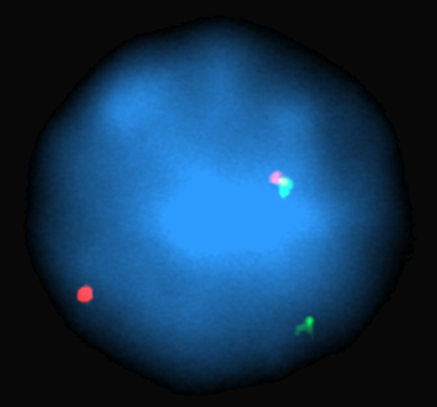
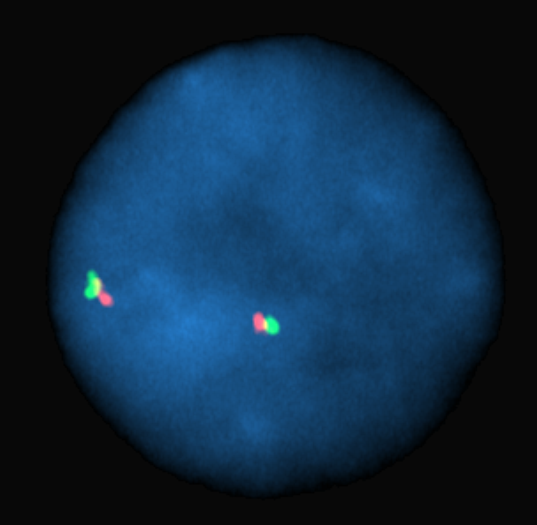
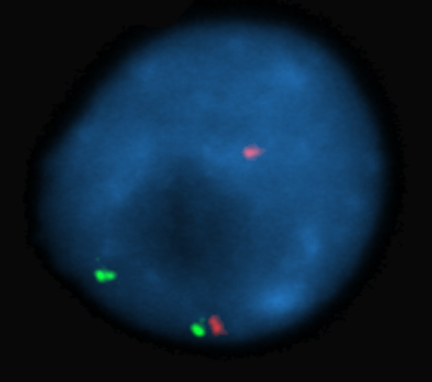
FISH
MYC
BCL6
BCL2

Slide 15
Final proposed diagnosis
High-grade B-cell lymphoma with MYC and BCL2 gene rearrangements and TDT expression

Slide 16
Clinical Evolution
Treatment – 6 cycles DA-EPOCH – complete remission
Disease relapse after 2 months
Treatment - GEMOx
Passed away due to disease progression one month later

Slide 17
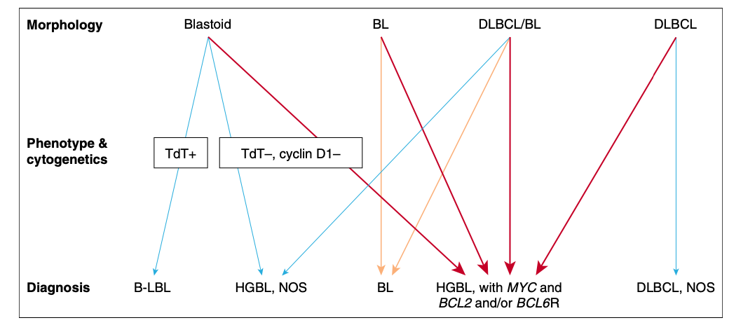
WHO – 4rth edition revised
Recognized “B-lymphoblastic lymphoma/ leukemia transformed from follicular lymphoma ”
Notes:
Eu trouxe este caso para ilustrar a evolução da nomenclatura atribuída a casos semelhantes desde a revisão da quarta edição da classificação OMS. De acordo com essa edição, qualquer Linfoma B agressivo com morfologia blastoide e imunoexpressão de TDT deveria ser classificado como Linfoma linfoblástico, sem levar em consideração características clínicas, epidemiológicas, citogenéticas ou moleculares. A edição neste momento fazia apenas uma distinção a neoplasias semelhantes que surgiam em pacientes mais velhos, com antecedente conhecido de Linfoma folicular e que deveriam ser classificadas ainda como linfoma linfoblástico, porém com o adendo “transformado a partir de um Linfoma folicular”. Então de acordo com essa edição, nosso caso que não tinha antecedente conhecido de Linfoma folicular teria sido classificado apenas como linfoma linfoblástico.

Slide 18
Classification dilemma
TDT expressing B-cell neoplasms with several characteristics different from lymphoblastic lymphoma:
Did not share the same clinical and epidemiological characteristics (older patients, lymphomatous presentation, rare BM involvement, frequent association with other mature B-cell lymphomas - follicular lymphoma, high grade B-cell lymphoma...
Morphology and immunohistochemistry pattern were diverse (more heterogeneous morphology and heterogeneous staining for CD20, TDT (weaker and partial expression), BCL6 and invariable CD34 negativity
Strong association with MYC/ MYC + BCL2/ MYC + BCL6 and MYC + BCL2 + BCL6 rearrangements
Did not respond well to treatment regimens for lymphoblastic lymphoma
Adverse prognosis
Notes:
Vários grupos começaram a reportar casos semelhantes e observar que esse grupo de neoplasias era sim diferente de um linfoma linfoblástico SOE,

Slide 19
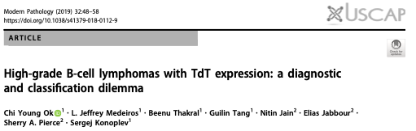
MYC + BCL2 = 3 patients
MYC + BCL2 + BCL6 = 3 patients
6 patients
*Blastoid-appearing
*TdT-positive
*CD20-weak/negative
*Lack expression of BCL6 and/or light chains
*Lack of CD34 expression
MYC + BCL2 = 1 patient
Not performed = 1 patient
Insufficient material = 1 patient
3 patients
2 patients
MYC + BCL2 = 1 patient
Not performed = 1 patient
2 patients
MYC = 1 patient – EBV+ DLBCL
No rearrangements = 1 patient – blastoid MCL
Notes:
No entando o conhecimento continua a evoluir e baseado nele há as mudanças de classificação e nessa época, vários grupos já advogavam que essa classe de neoplasias era sim diferente de um linfoma linfoblástico SOE, não compartilhavam das mesmas características clínicas e epidemiológicas (pacientes mais velhor, apresentação linfomatosa, raro envolvimento de MO, , a morfologia e o padrão de imuno-histoquímica eram diversos

Slide 20
All patients had a dismal outcome despite being treated with intensive chemotherapy
“It seems likely that these patients will require novel therapeutic approaches, and we suggest that TdT-positive mature B-cell lymphomas need to be segregated to facilitate the design of better therapies and foster additional research”

Slide 21
*258 LBCL/ HGBCL – 6 (2%) cases (TDT expression >10% cells)
*Morphology – blastoid appearing – 6/6
*Previous lymphoma (5/6)
*Immunophenotype
*MYC rearrangements – 6/6 (1 MYC / 3 MYC + BCL2/ 1 MYC + BCL6/ 1 MYC + BCL6 + BCL2)
*Clinical features and course
*Mutational landscape
*Patterns of genomic Evolution
* Meta-analysis included the 6 TdT+ cases from the current study and 40 additional cases from 18 different studies (46 cases) - clinical, morphologic, phenotypic, and cytogenetic features

Slide 22
Clinical features and course

Slide 23
Mutational landscape

Slide 24
Immunophenotype
* Meta-analysis included the 6 TdT+ cases from the current study and 40 additional cases from 18 different studies (46 cases)

Slide 25
WHO – 5th edition 2022
Approximately 2% of DLBCL/HGBCL-MYC/BCL2 cases have been reported to contain TdT-positive tumour B cells ranging from rare positive cells to near-uniform expression. Such cases may be CD20-weak/negative and lack expression of BCL6 and/or light chains, indicating a more immature phenotype

Slide 26
ICC - 2022

Slide 28
Conclusion
Mophologically blastoid with IHC features of immaturity and TDT expression, CD34 negative
Older patients, lymphomatous presentation
Strong association with MYC rearrangement with BCL2, BCL2 + BCL6 or BCL6
Rearrangements in MYC and BCL2 and/or BCL6 are extremely rare in de novo B-lymphoblastic lymphoma/leukemia (0,2%)
The mutational profiles were more like those reported in germinal center B-cell type-diffuse LBCL rather than B-LBL

Slide 29
Conclusion
The mechanism of TdT expression in these cases remains unclear
The transformation from FL is a well-accepted phenomenon
Frequently related to progression, relapse or transformation of other B-cell lymphomas
These patients have a dismal prognosis despite receiving chemotherapy designed for B-lymphoblastic lymphoma/ leucemia or High grade B-cell lymphoma
Optimal therapy yet to be defined

Slide 30
obrigadA

Slide 31
THANK YOU

